Slide 1
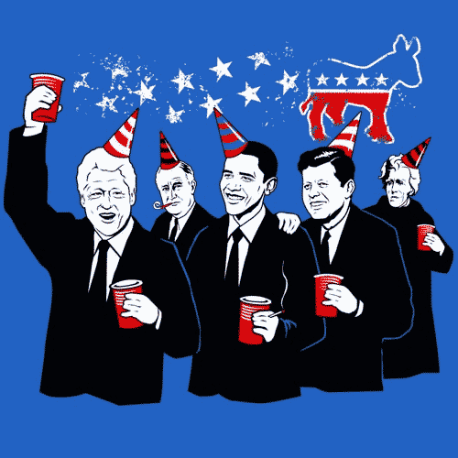
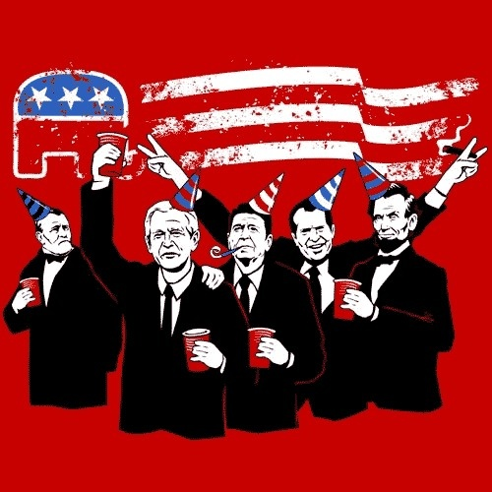
The Political Parties in the Electoral Process

Slide 2
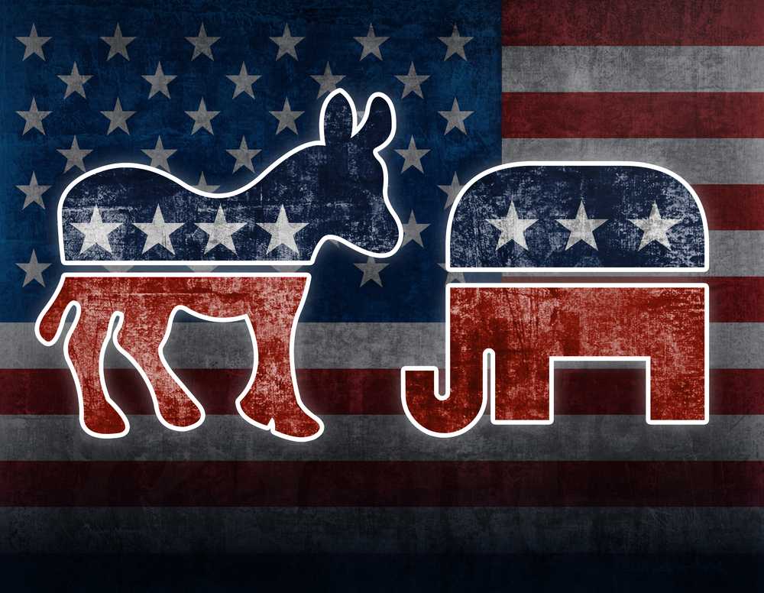
Political Parties
Formal Definition: A “team of men [and women] seeking to gain governmental power by gaining office through constituted elections.”
Anyone can join
Serves as the face, or “brand” for set of beliefs
Links people to government

Slide 3
Roles of Political Parties: What do they do?
Party as an Organization:
Federal, state, and county chapters plan events, recruit members, and make party rules during non-election years
Party in Government:
Elected officials try to push political agenda and create public policy
Legislative and Executive branches use power in numbers
Party in the Electorate:
Gain political power through electing candidates to public office

Slide 4
Political Parties in the Election Process
Recruit/Select candidates
Run campaigns
Contact Voters
Promote Platform

Slide 5
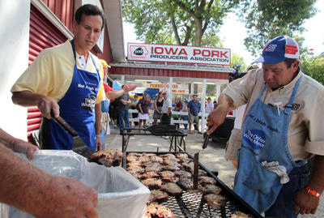
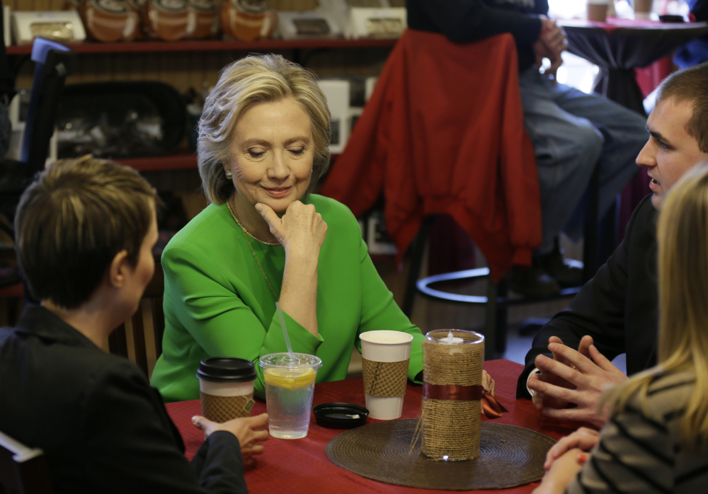
Recruiting and Selecting Candidates
Who has the best chance of winning?
Personality
Liked
Trustworthy
Accomplishments
Experience
Beliefs
Discuss: What qualities do you look for in a candidate?

Slide 6
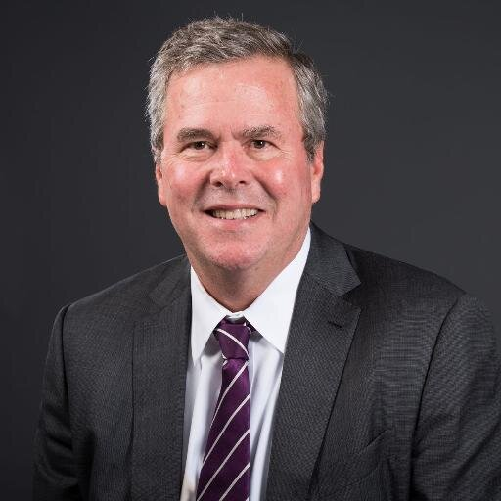
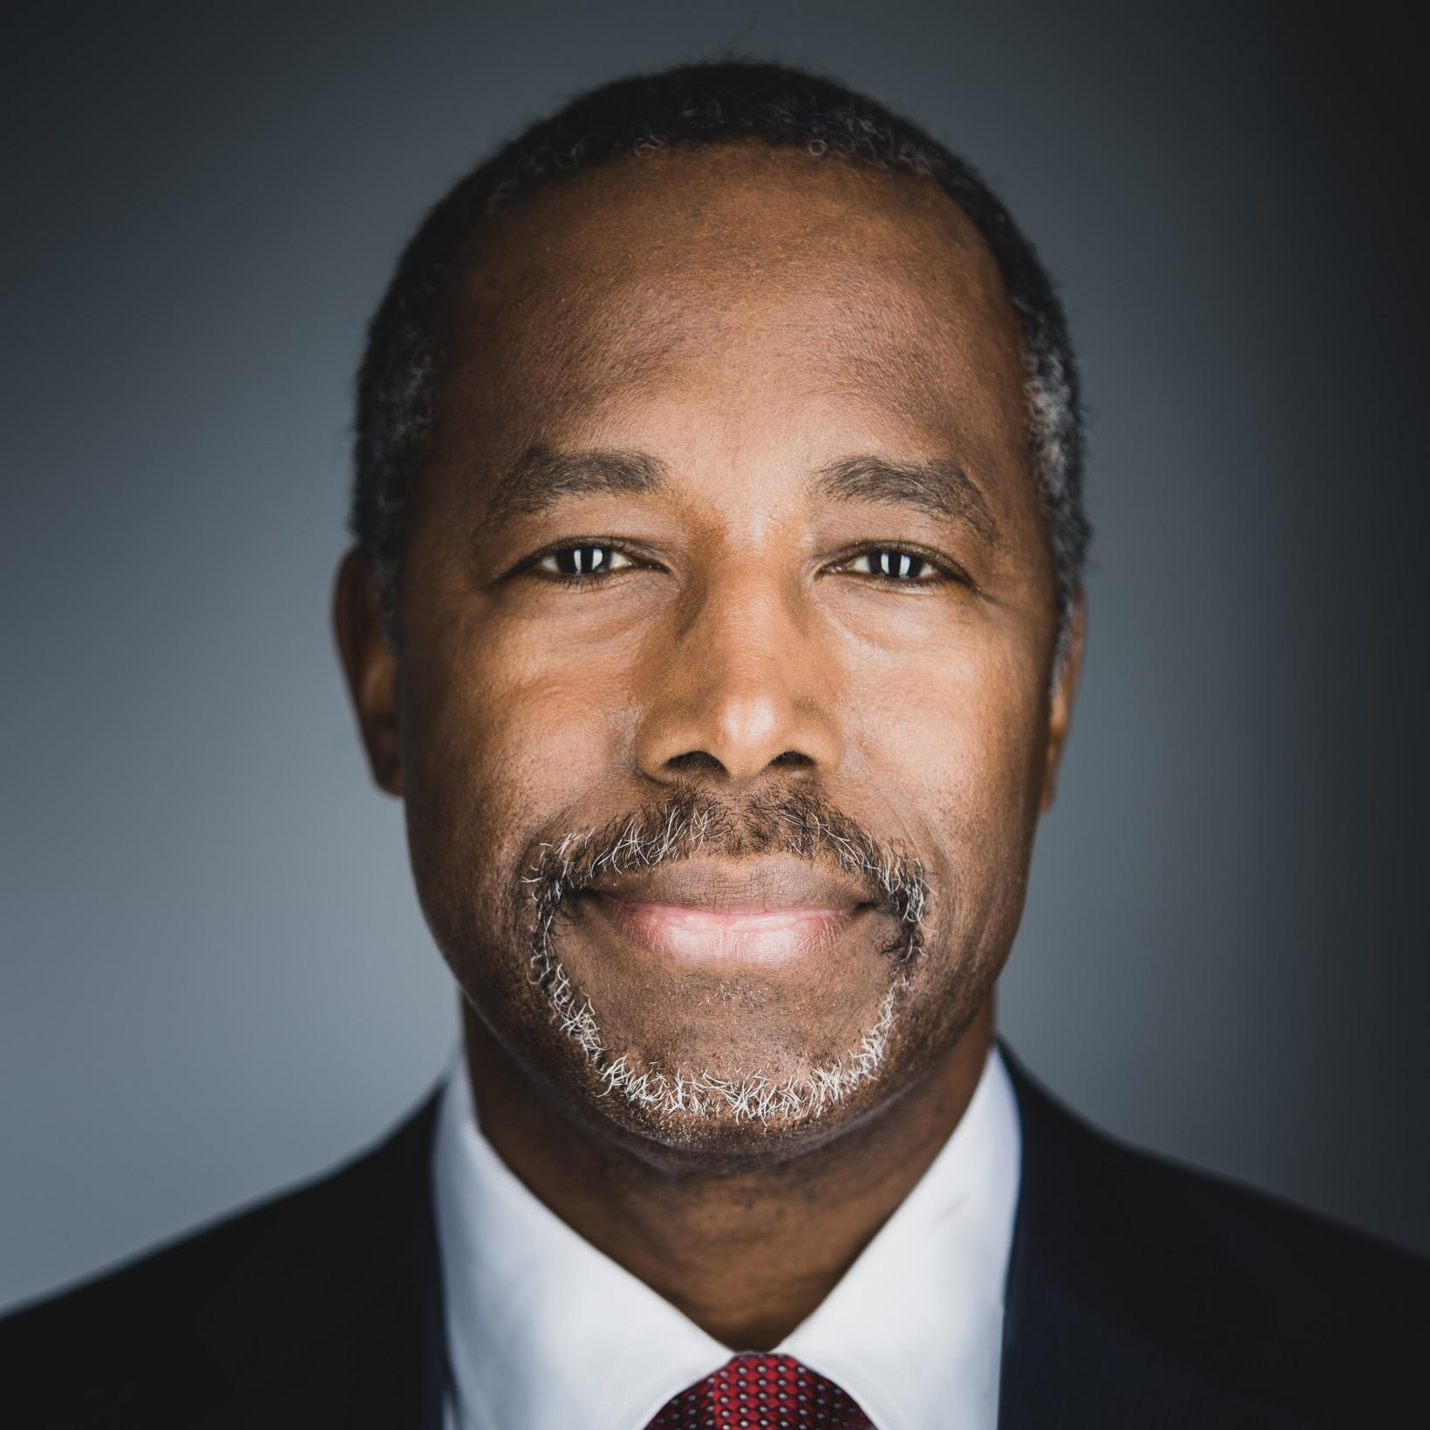
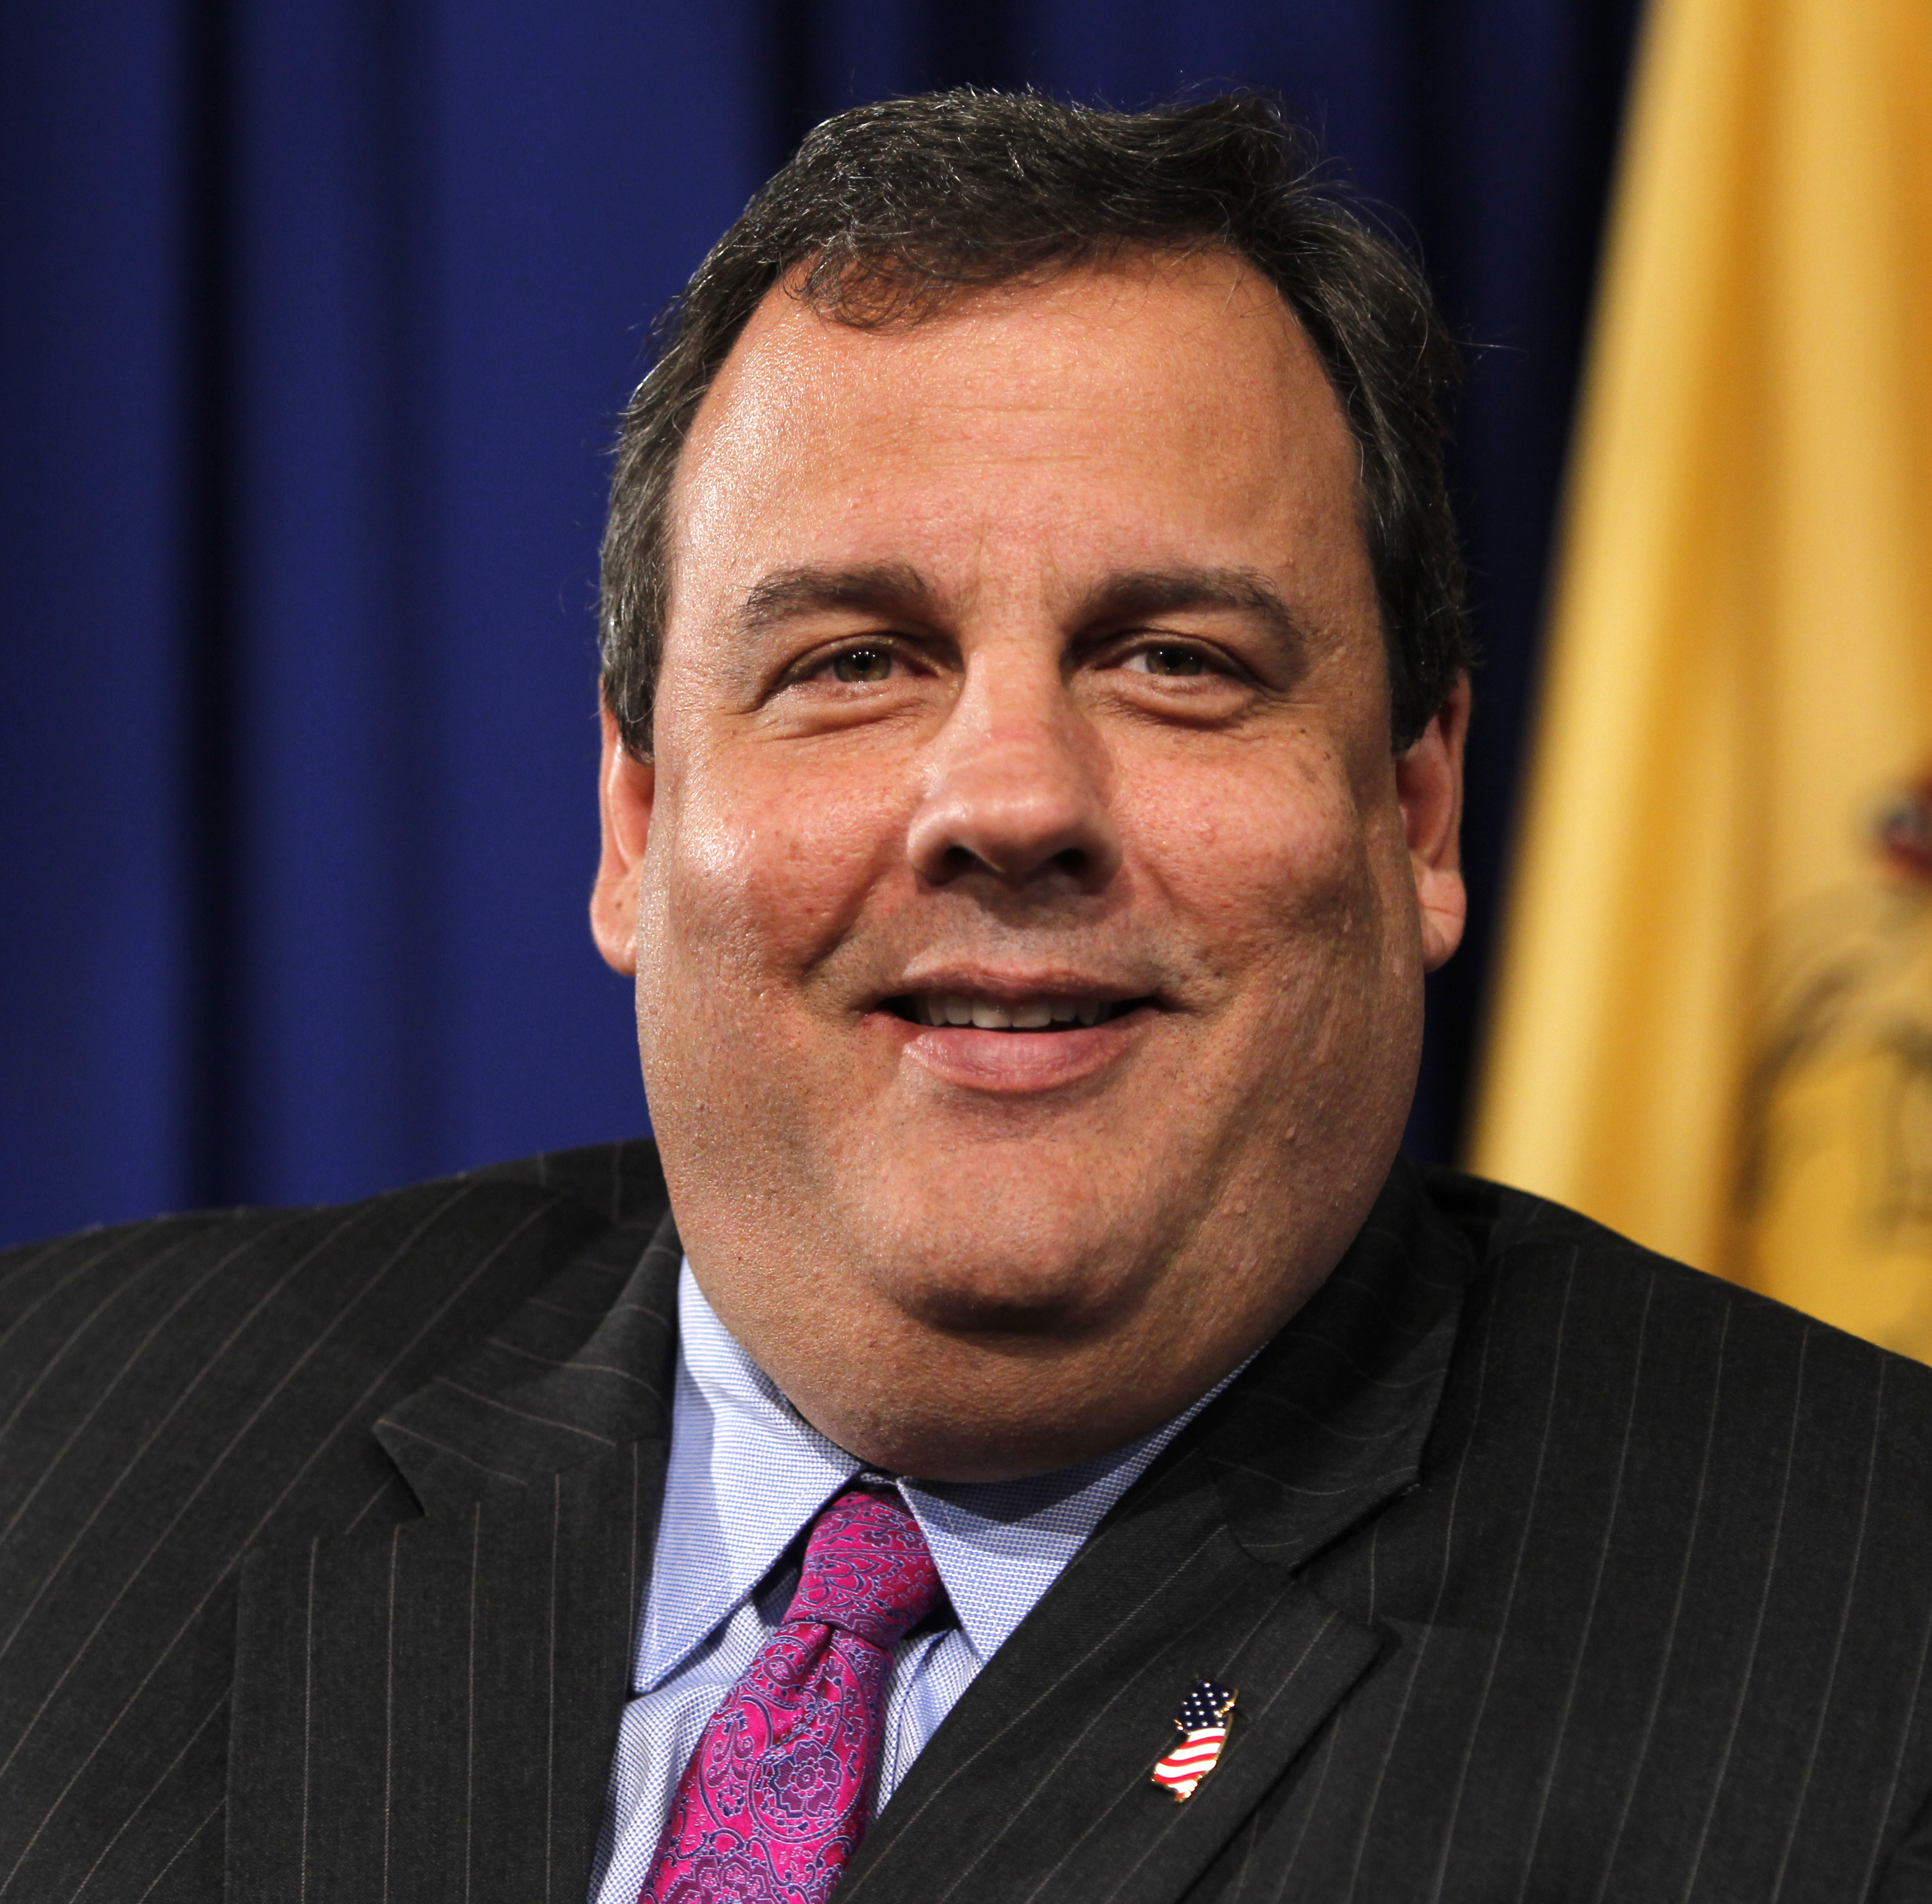
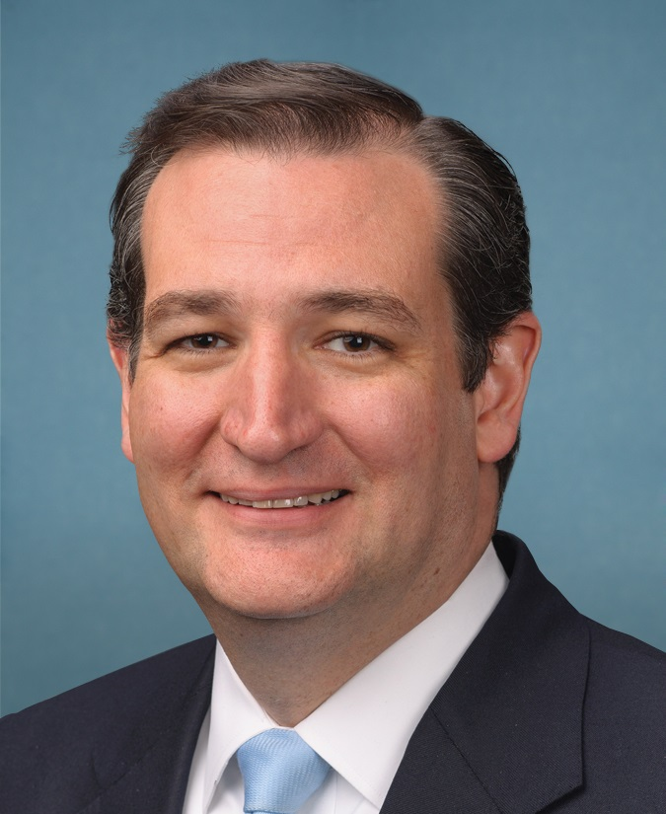
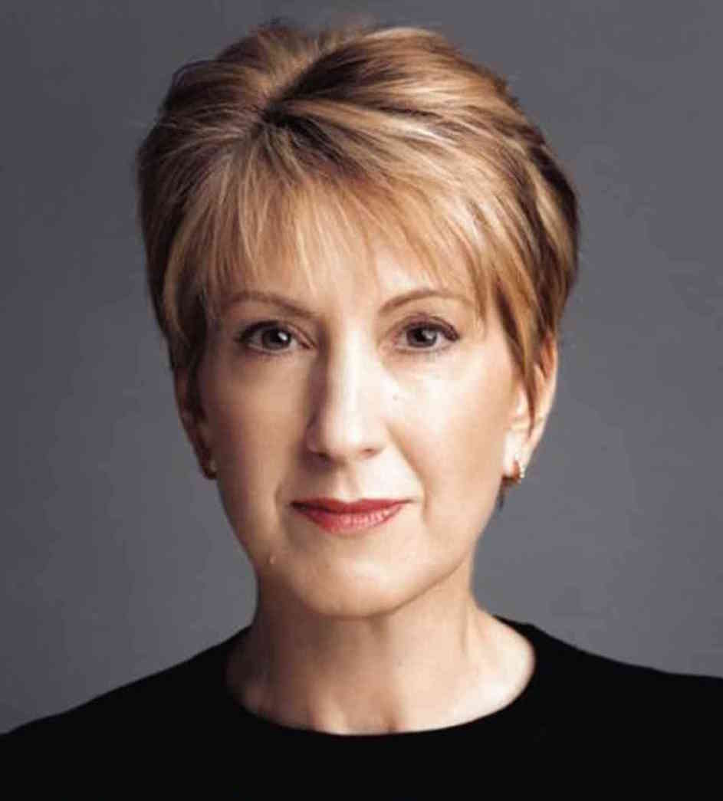
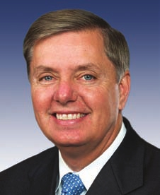
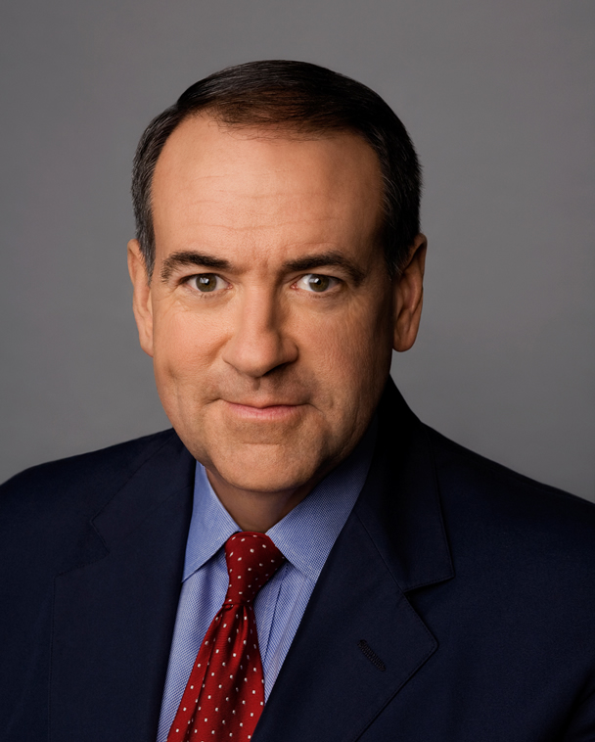
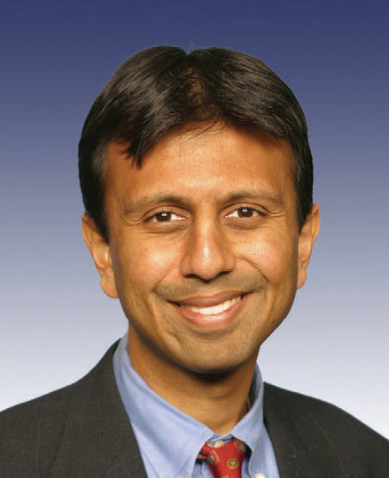
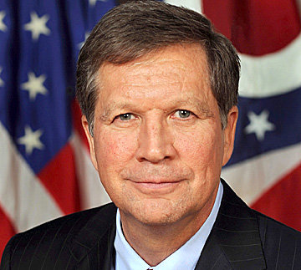
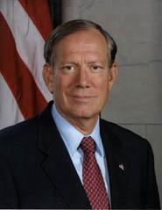
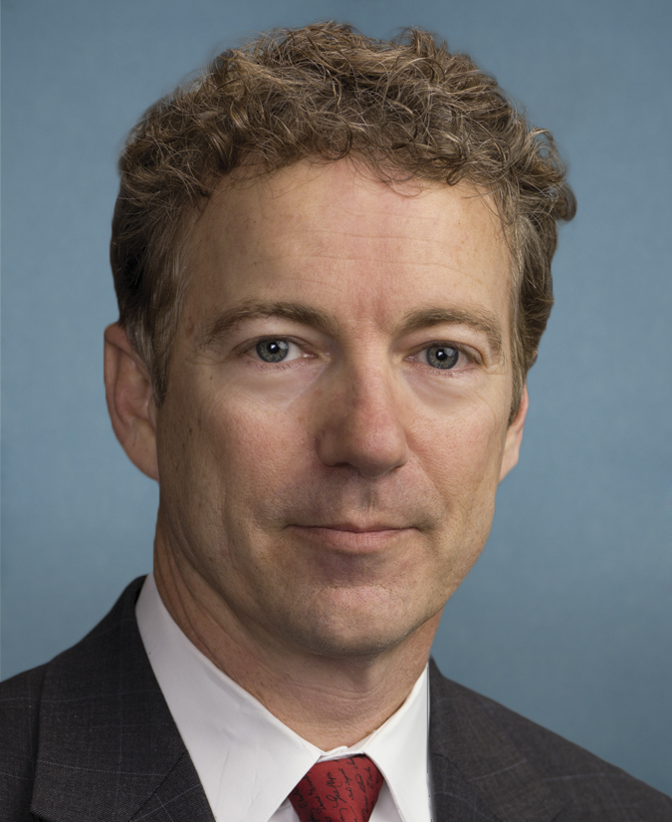
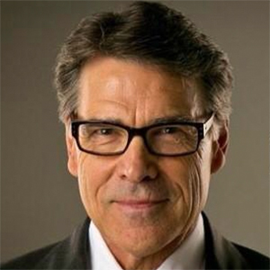
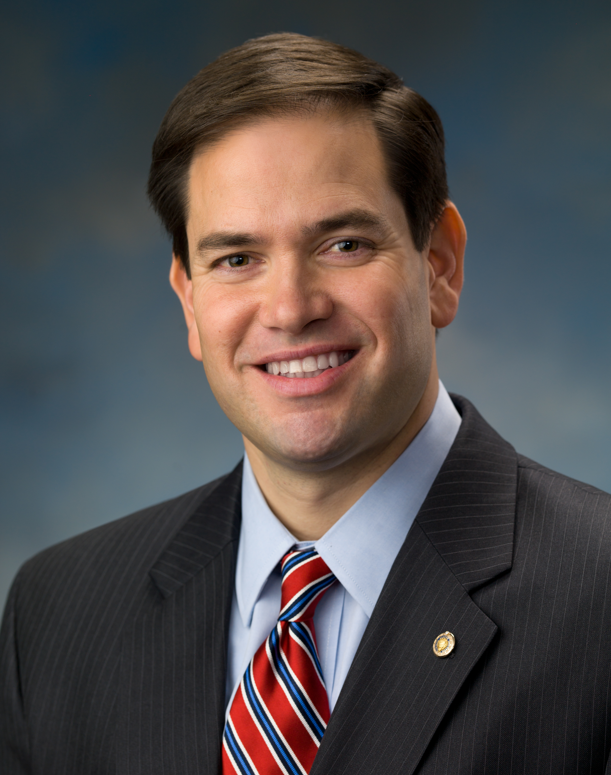
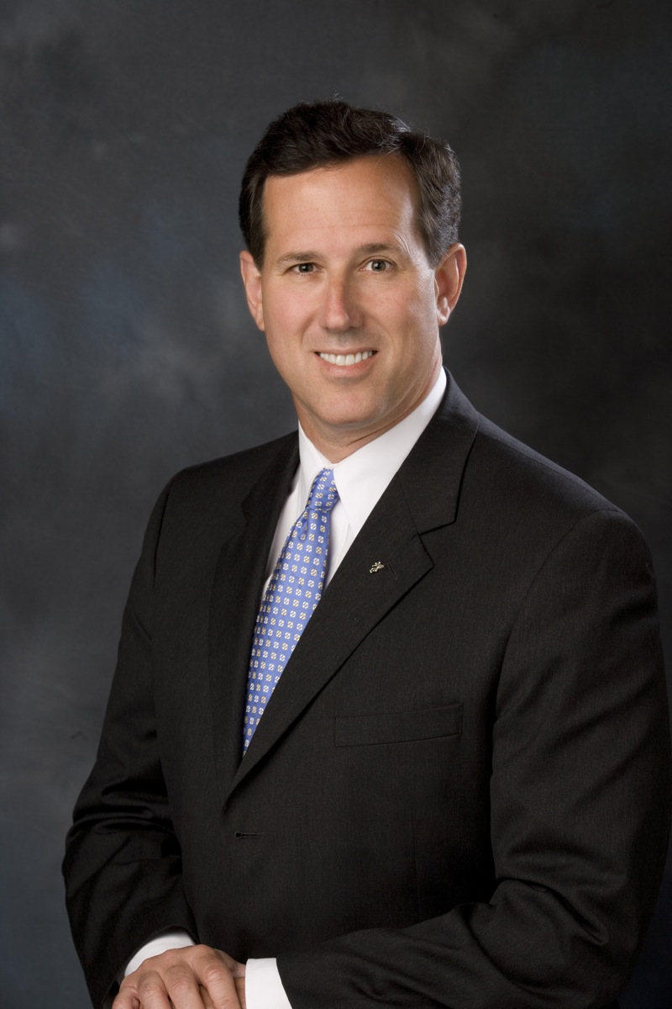
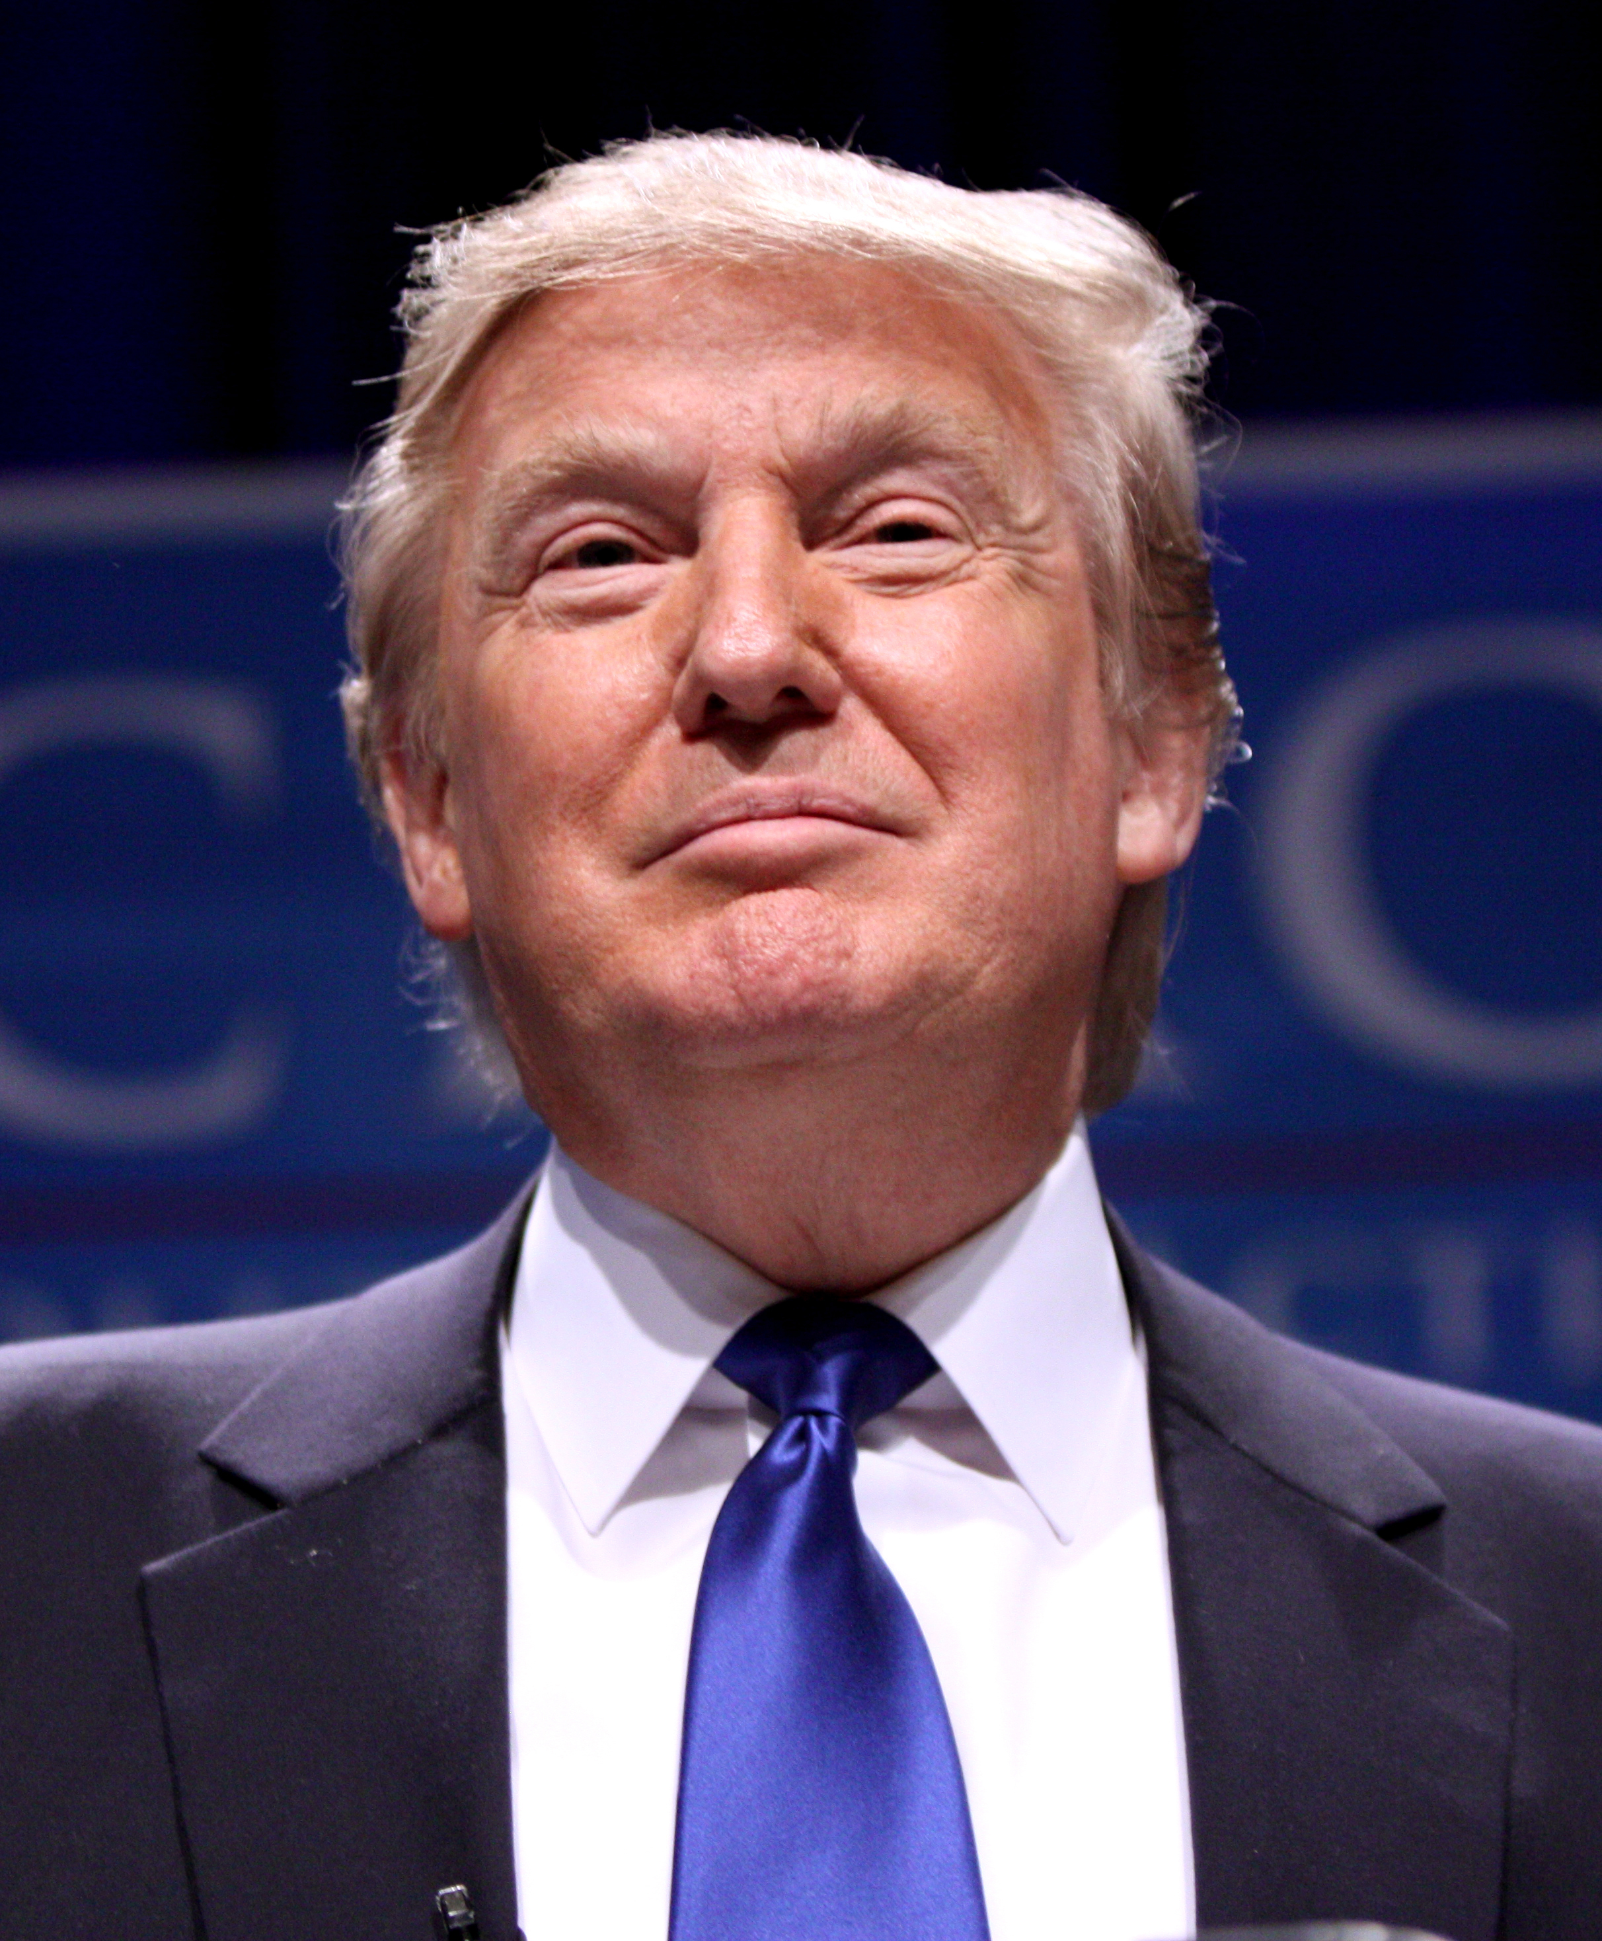
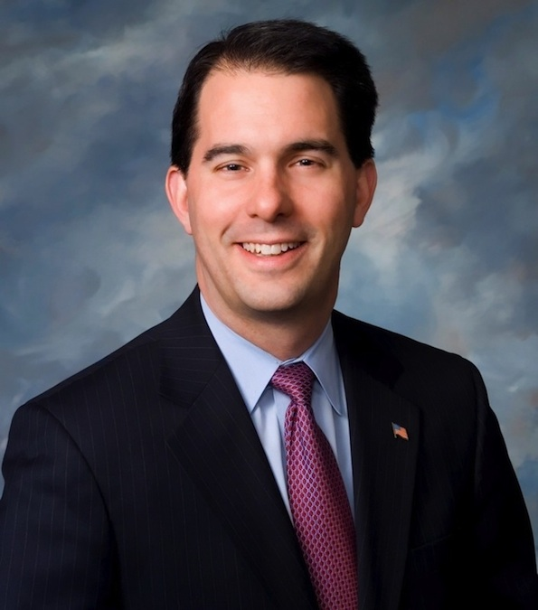
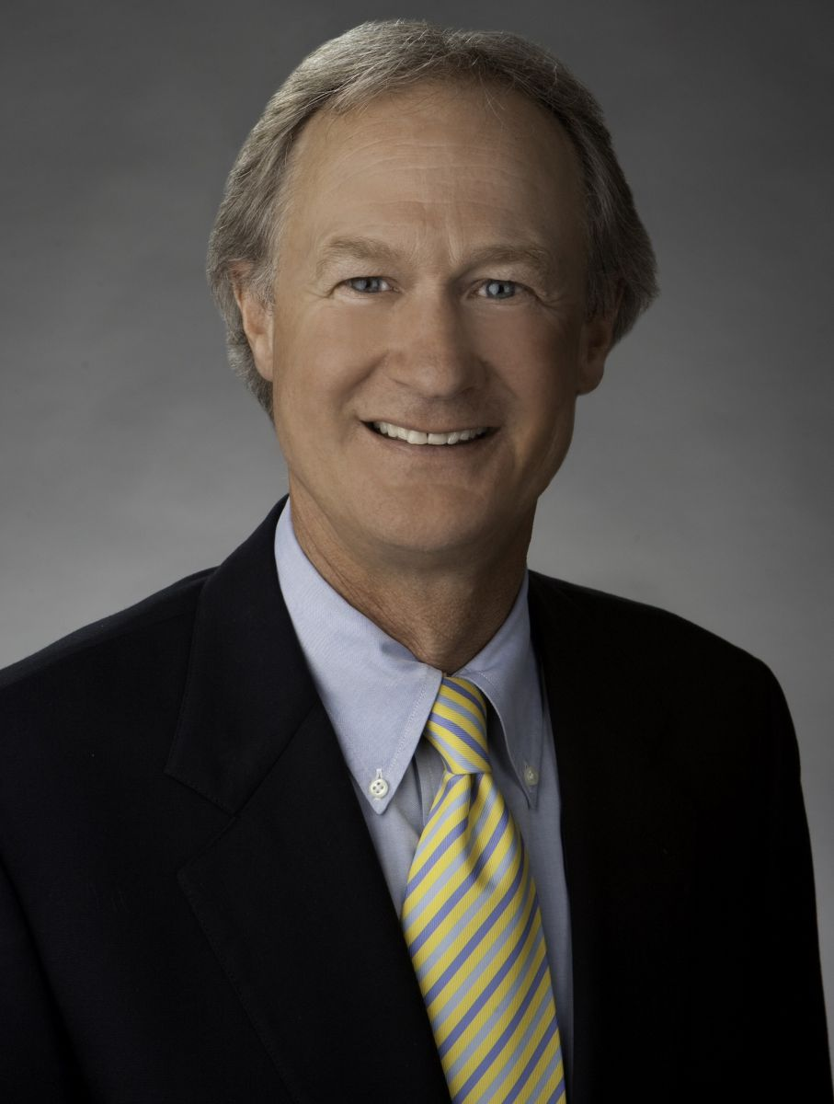
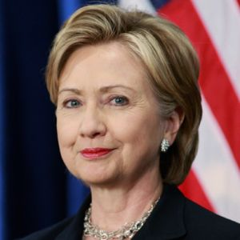
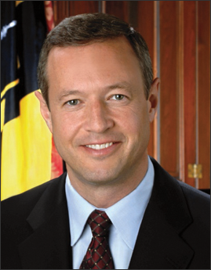
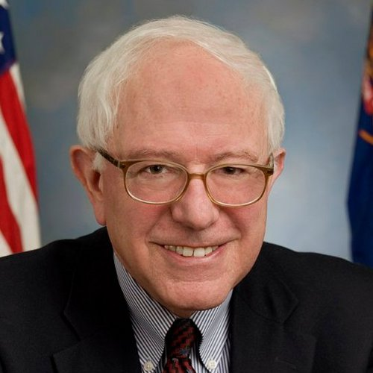
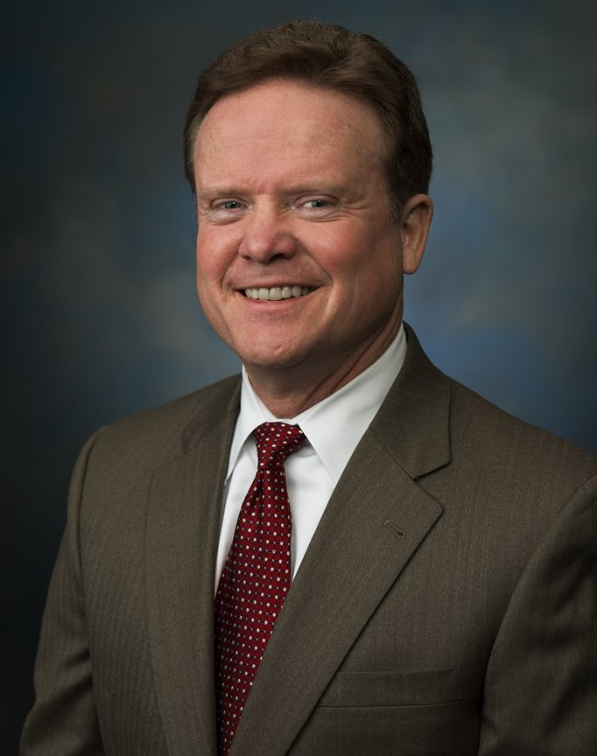
The Road to 2016: How many candidates can you name?

Slide 7
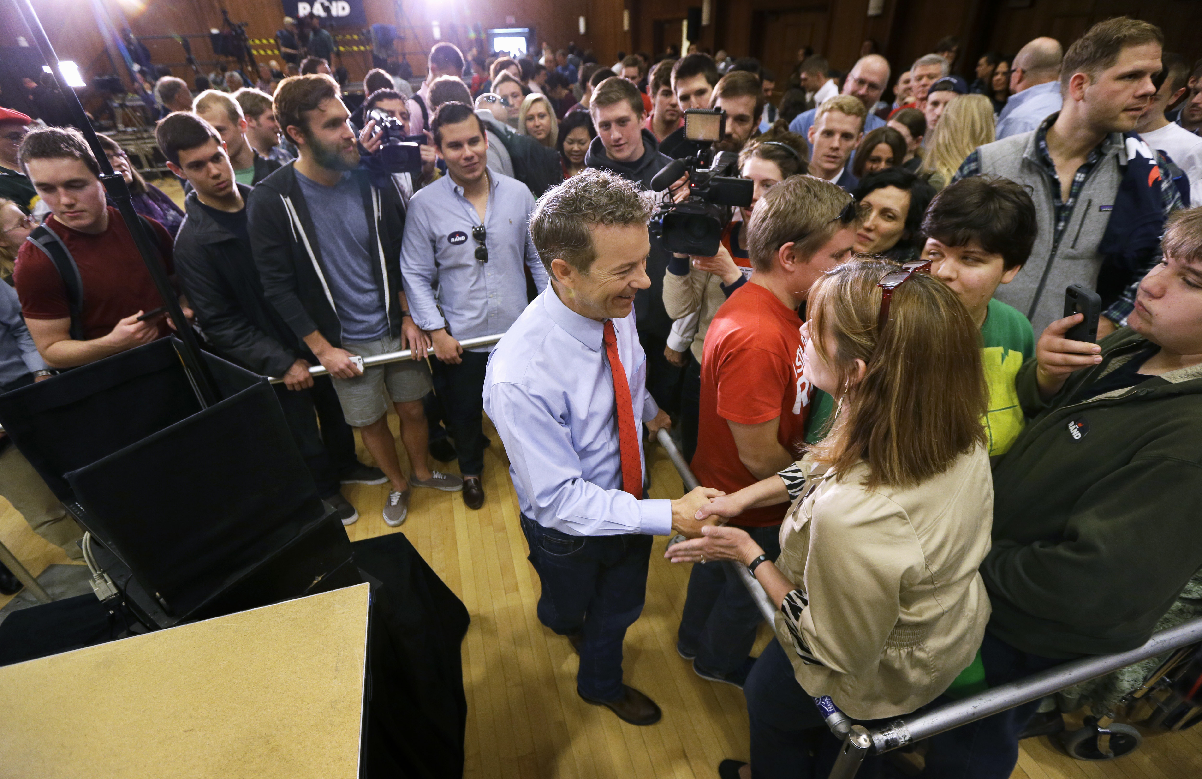
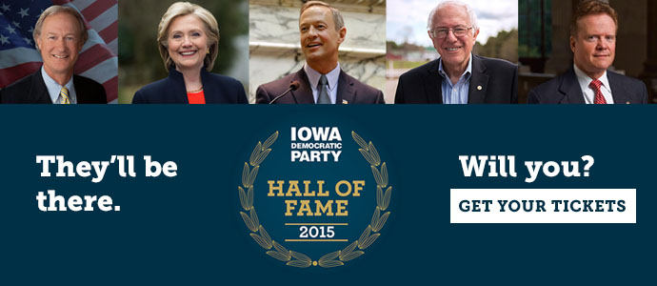
Running Campaigns
Raising money
Advertisements
Organize Debates
Media Events
Recruiting Volunteers

Slide 8
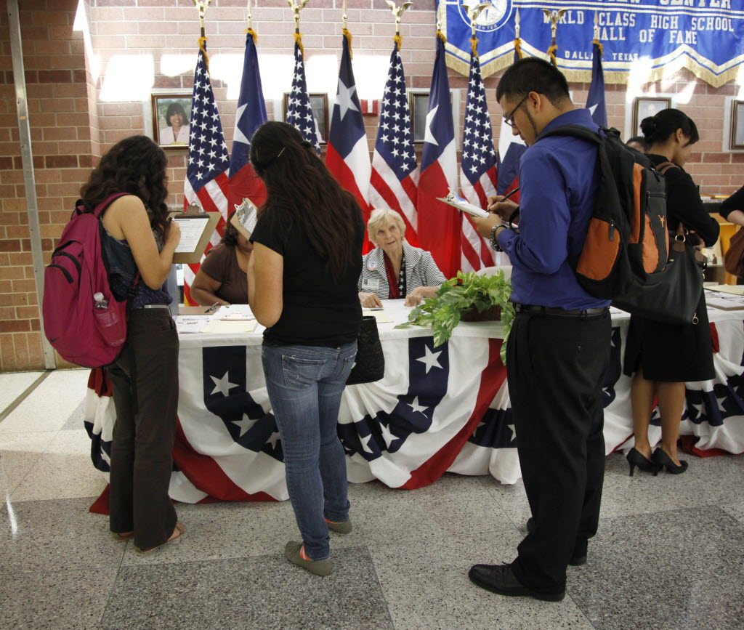
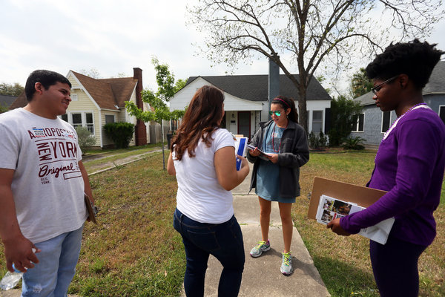
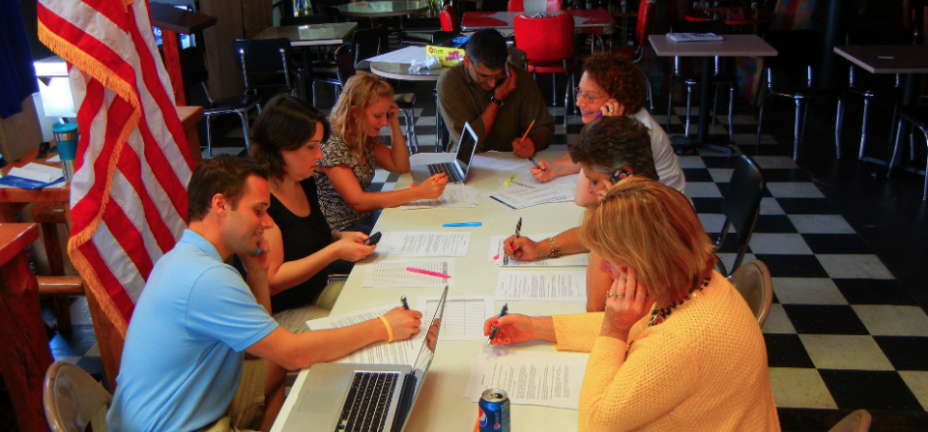
Contacting Voters
Outreach to voters to increase caucus turnout
Phone Calls (Phone Banks)
Door-Knocking
Voter Registration Drives
Mail

Slide 9
Promote Platform
Platform: statement of beliefs and policies
Signals to voters what the party believes in
Voters know what they are getting
Most active party members have greatest influence on changes
Iowa GOP Platform: http://www.iowagop.org/platform-2014/
Iowa Democratic Party Platform: http://iowademocrats.org/site/wp-content/uploads/2015/05/2014-Iowa-Democratic-Party-State-Platform.pdf

